Slide 1
DC Machines
Prepared by:
Prof. J. M. SHAH

Slide 2
Overview
A DC machine is an electromechanical device that is used to convert electrical energy into mechanical energy or vice versa.
The DC machine used to convert electrical energy into mechanical energy, which is known as DC motor and the DC machine used to convert mechanical energy into electrical energy, which is known as DC generator.
The same machine can be used either as a motor or generator. The construction is same for DC motor and DC generator.

Slide 3
CONSTRUCTION
Constructional parts Of DC Machine
Yoke:
Field electromagnets:
Pole core and pole shoe:
Armature:
Field Coil:
Commutator:
Brushes:
Shaft:
Bearings:

Slide 4
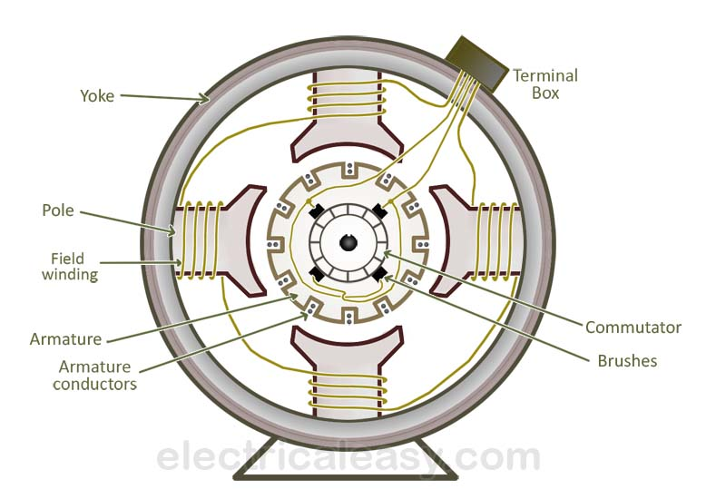
CONSTRUCTION

Slide 5
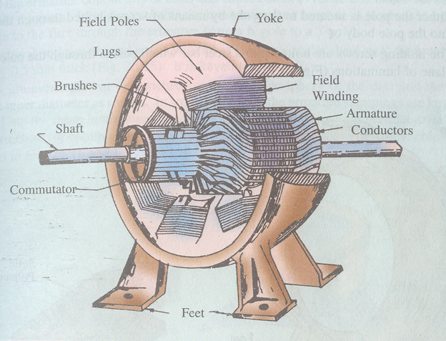
Practical DC Machine

Slide 6
1)Yoke
The outer frame of a dc machine is called as yoke. It is made up of cast iron or steel. It not only provides mechanical strength to the whole assembly but also carries the magnetic flux produced by the field winding.
Acts as frame of the machine
- Mechanical support
- low reluctance for magnetic flux
- High Permeability

Slide 7
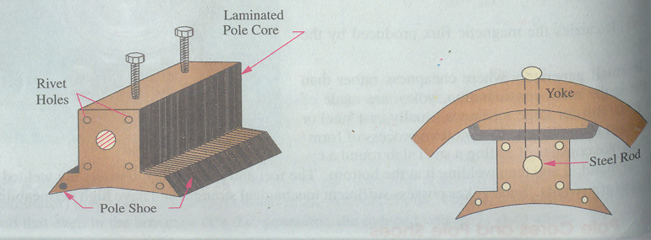
2)Pole cores and pole shoes
Poles are joined to the yoke with the help of bolts or welding. They carry field winding and pole shoes are fastened to them. Pole shoes serve two purposes; (i) they support field coils and (ii) spread out the flux uniformly.

Slide 8
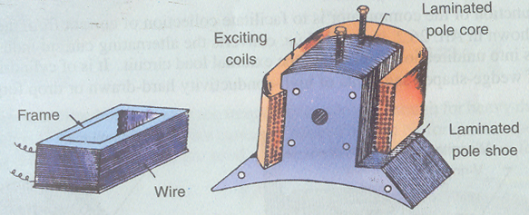
3) Field coils:-
They are usually made of copper. Field coils are former wound and placed on each pole and are connected in series. They are wound in such a way that, when energized, they form alternate North and South poles.

Slide 9
4) Armature core and Armature winding:
It is cylindrical in shape with slots to carry armature winding. The armature is built up of thin laminated circular steel disks for reducing eddy current losses.
It is usually a former wound copper coil which rests in armature slots. The armature conductors are insulated from each other and also from the armature core. Armature winding can be wound by one of the two methods; lap winding or wave winding.

Slide 10
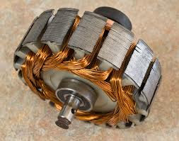
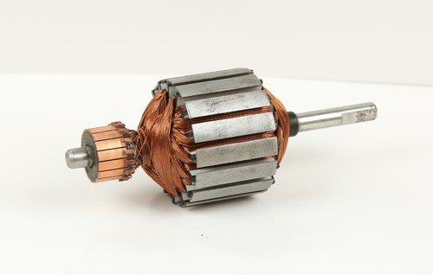
Cont..
Armature core and Armature winding

Slide 11
4)Commutator
The function of a commutator, in a dc generator, is to collect the current generated in armature conductors. Whereas, in case of a dc motor, commutator helps in providing current to the armature conductors.
A commutator consists of a set of copper segments which are insulated from each other. The number of segments is equal to the number of armature coils.

Slide 12
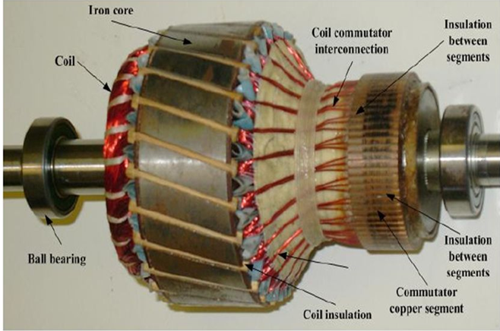
CONT..

Slide 13
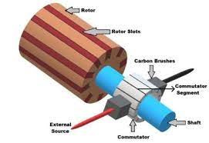
5) Brushes
Brushes are usually made from carbon or graphite. They rest on commutator segments and slide on the segments when the commutator rotates keeping the physical contact to collect or supply the current.

Slide 14
WORKING OF DC GENERATOR
It converts the Mechanical Energy into Electrical Energy (in DC).
Its working principle is Faraday's Law of Electromagnetic Induction which states that, whenever a conductor is placed in a varying magnetic field (or conductor is moved in magnetic field), then an emf is induced in it.
If the circuit of the conductor is closed, then current also starts flowing through it. Direction of the Induced Current can be determined by Fleming's Right Hand Rule.

Slide 15
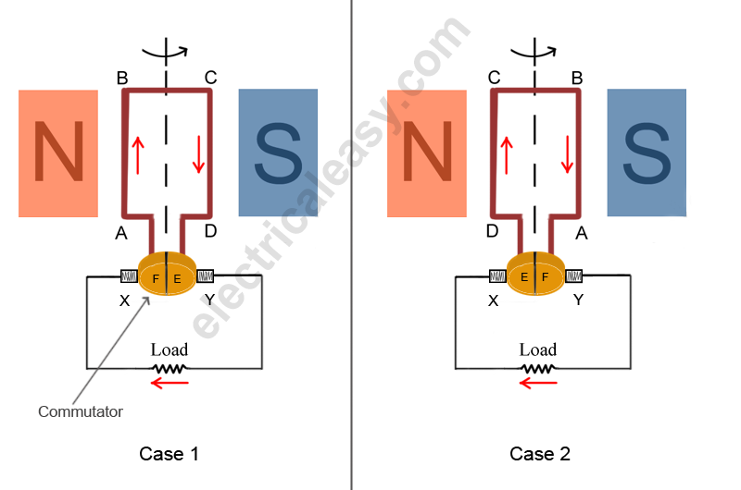
Split ring commutator

Slide 16
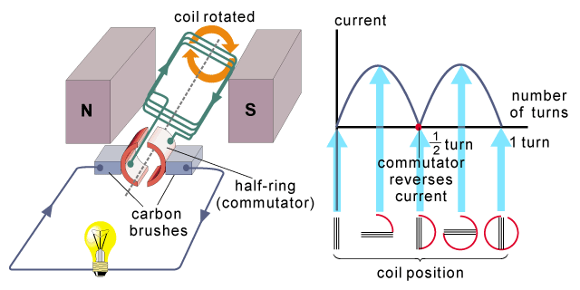
Induced DC voltage

Slide 17

E.M.F Equation of DC generator
P – number of poles of the machine
ϕ – Flux per pole in Weber.
Z – Total number of armature conductors.
N – Speed of armature in revolution per minute (r.p.m).
A – number of parallel paths in the armature winding.
If Lap winding type then A=P
If Wave winding type then A=2

Slide 18
example
A d.c. machine has 6-poles and the armature is lap-connected with 864 conductors rotating at 600 rpm. The flux per pole is 0.05 Wb. Calculate the the emf generated?

Slide 19
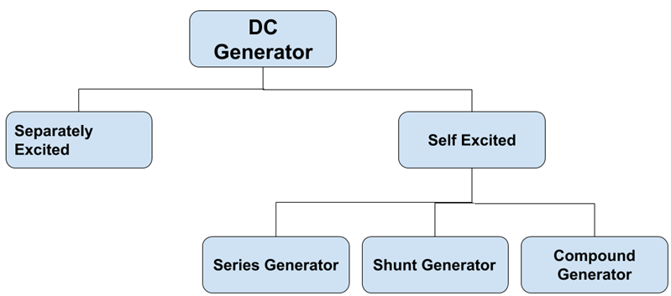
Classification of DC Machine
According to the field excitation method, the DC machines are classified as;

Slide 20
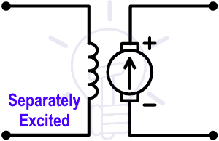
Separately Excited DC Machine

Slide 21
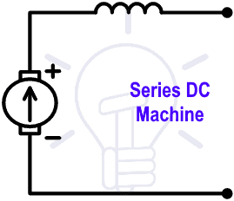
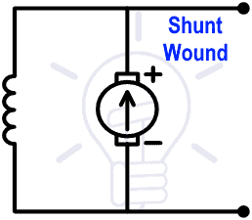
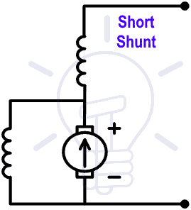
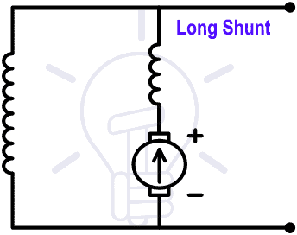
Self Excited DC Machine

Slide 22
Working principle of a DC motor
"whenever a current carrying conductor is placed in a magnetic field, it experiences a mechanical force".
The direction of this force is given by Fleming's left-hand rule and its magnitude is given by
F = BIL.
When armature windings are connected to a DC supply, an electric current sets up in the winding. Magnetic field provided by field winding.
In this case, current carrying armature conductors experience a force due to the magnetic field and hence it moves.

Slide 23
Back EMF
When the armature of a motor is rotating, the conductors are also cutting the magnetic flux lines and hence according to the Faraday's law of electromagnetic induction, an emf induces in the armature conductors. The direction of this induced emf is such that it opposes the armature current (I_{a}). So it is called the back emf.
Magnitude of the Back emf can be given by emf equation of a DC generator.

Slide 24
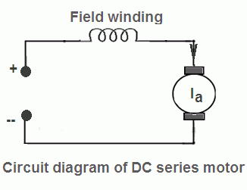
Dc motor series circuit
I = I_{a} = I_{s}
V = E_{b} + I_{a}(R_{a} + R_{s})

Slide 25

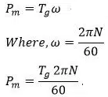
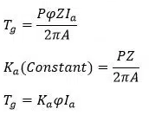
Torque Equation

Slide 26
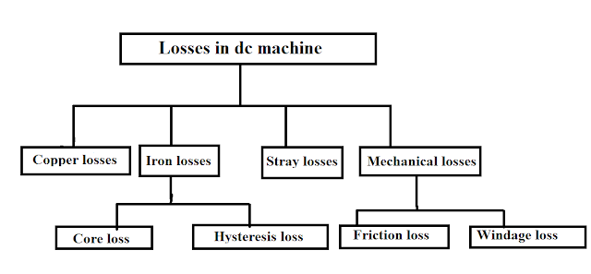
Losses in DC machines

Slide 27
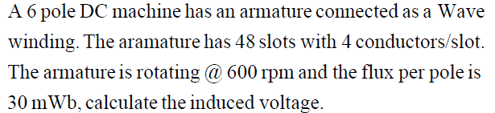

EXAMPLE

Slide 28
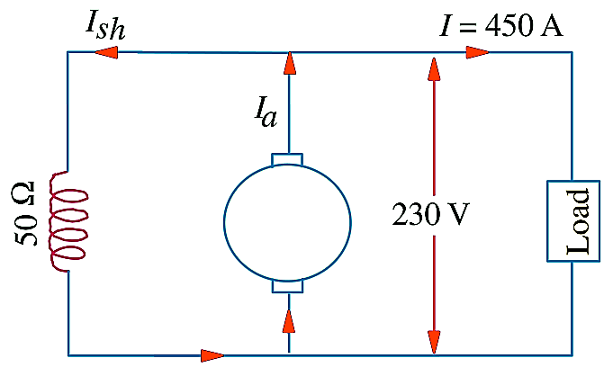
EXAMPLE
A shunt generator delivers 450 A at 230 V and the resistance of the shunt field and armature are 50 Ω and 0.03 Ω respectively. Calculate the generated e.m.f.

Slide 29




Solution

Slide 30
EXAMPLE
A long-shunt compound generator delivers a load current of 50 A at 500 V and has armature, series field and shunt field resistances of 0.05 Ω, 0.03 Ω and 250 Ω respectively. Calculate the generated voltage and the armature current. Allow 1 V per brush for contact drop.

Slide 31
Solution

Slide 32




Solution

Slide 33
Solution

Slide 34
EXAMPLE
A short-shunt compound generator delivers a load current of 30 A at 220 V, and has armature, series-field and shunt-field resistances of 0.05 Ω, 0.30 Ω and 200 Ω respectively. Calculate the induced e.m.f. and the armature current. Allow 1.0 V per brush for contact drop.

Slide 35
Solution

Slide 36


Solution

Slide 37

Solution

Slide 38
EXAMPLE
An 8-pole d.c. shunt generator with 778 wave-connected armature conductors and running at 500 r.p.m. supplies a load of 12.5 Ω resistance at terminal voltage of 250 V. The armature resistance is 0.24 Ω and the field resistance is 250 Ω. Find the armature current, the induced e.m.f. and the flux per pole.

Slide 39
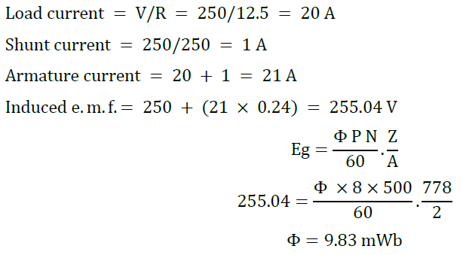
Solution

Slide 40
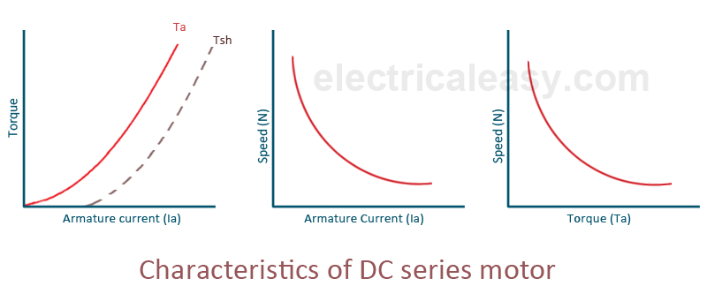
Speed –Torque Characteristics
T_{a} ∝ ɸ I_{a} and N ∝ E_{b}/ɸ

Slide 41
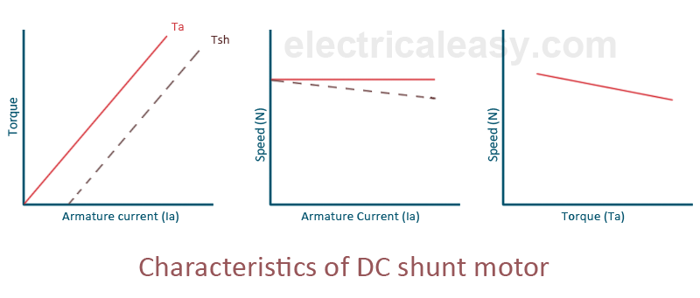
Speed –Torque Characteristics

Slide 42
Thanks

